Slide 1
AUTONOMY AT WORK
Huynh Anh Tu

Slide 2

01. What is autonomy at work? 02. Why does it so important? 03. How to have autonomy at work ? 04. How to encourage autonomy at work in an organization?
AUTONOMY AT WORK

Slide 3
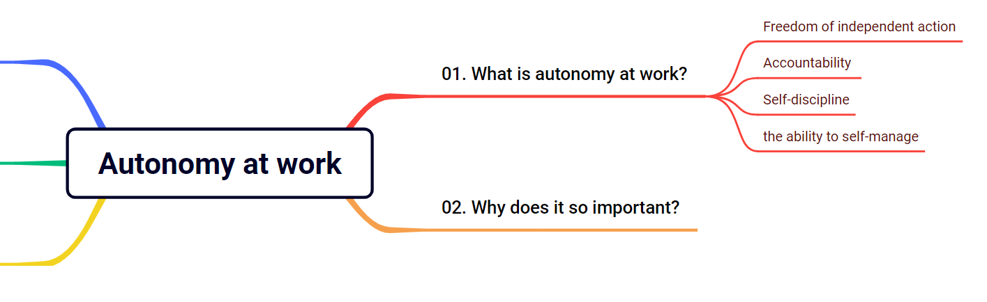
01. What is autonomy at work ?

Slide 4

01. What is autonomy at work ?
Autonomy at work is the ability to self-manage and run one's own affairs independently, without the supervision or direction of others.

Slide 5
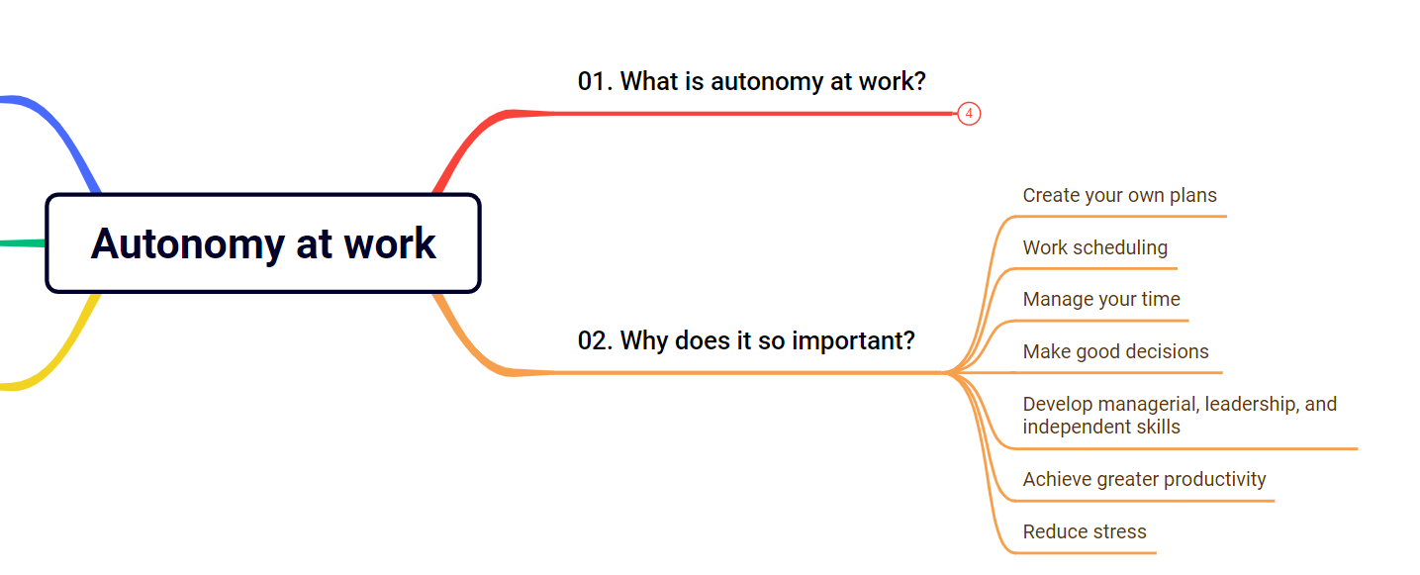
02. Why does it so important?

Slide 6

02. Why does it so important?
Autonomy at work helps us:
Create your own plans
Work scheduling
Manage your time
Make good decisions
Develop managerial, leadership, and independent skills
Achieve greater productivity
Reduce stress

Slide 7
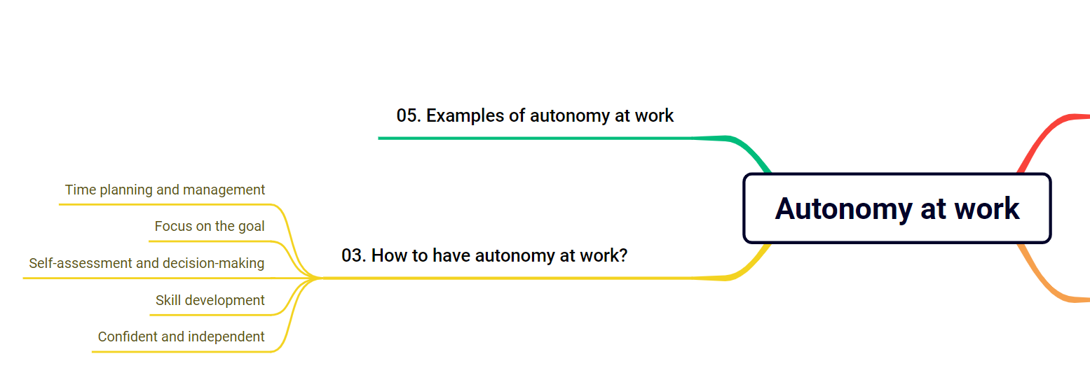
03. How to have autonomy at work?

Slide 8

03. How to have autonomy at work?
Time planning and management: Plan and manage your time properly so that you can get the job done on time.
Focus on the goal: Focus on the goal of the job and set specific goals.
Self-assessment and decision-making: Self-assessment and make the right decision.
Skill development: Learn from those who are better than you and set goals to develop your skills
Confident and independent: Make sure those decisions are right and can work best.

Slide 9
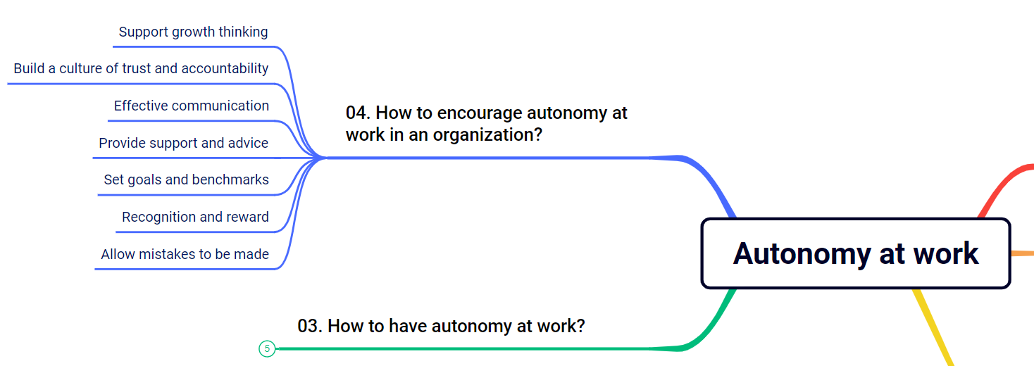
04. How to encourage autonomy at work in organization?

Slide 10
04. How to encourage autonomy at work in organization?
Support growth thinking: Supporting a growth mindset is a necessary first step.
Build a culture of trust and accountability: Make sure employees understand the responsibilities and should make decisions on their own.
Effective communication: Help employees understand goals and plans.
Provide support and advice: Be ready to provide support and advice.
Set goals and benchmarks: Set clear goals and evaluate your employees' performance fairly.
Recognition and reward: Recognize and reward employees when they achieve success at work.
Allow mistakes to be made: Allow employees to make mistakes and learn from their mistakes.

Slide 11
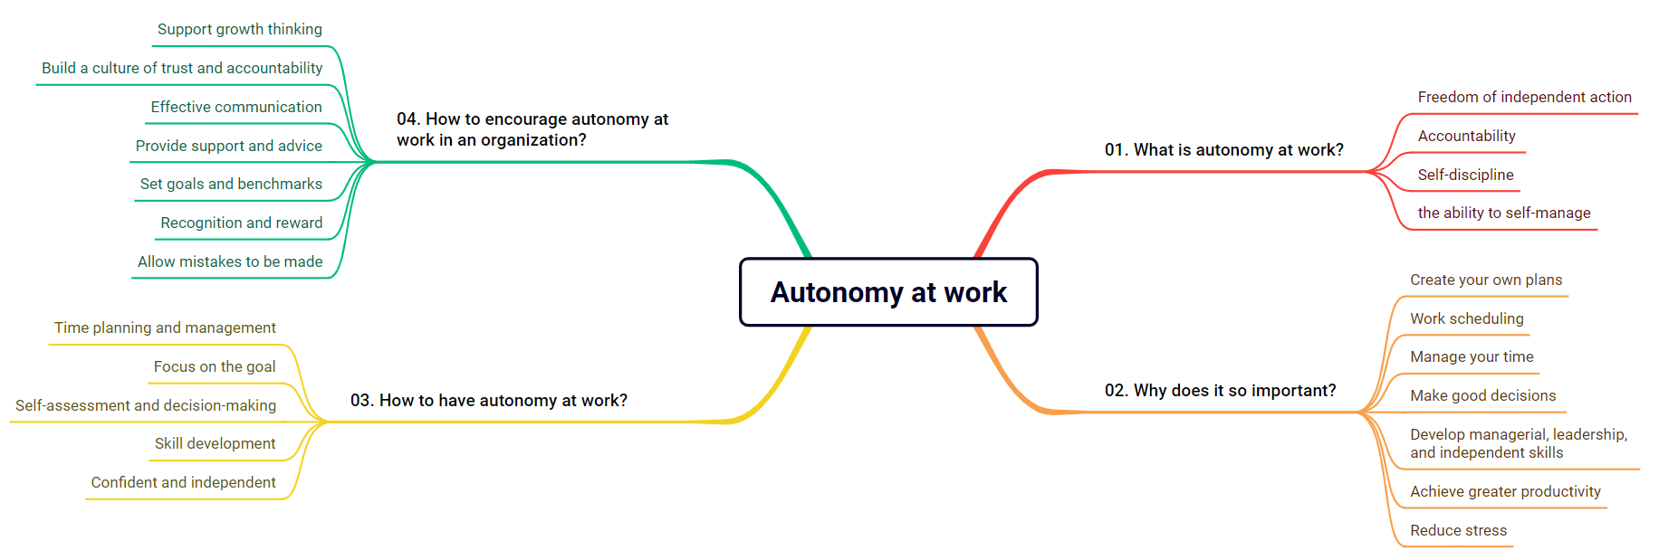
SUMMARY

Slide 12
THANKS!
Have a nice day!
Huynh Anh Tu
Phone: +84 929455098
Email: anhtu18042004@gmail.com

